Slide 1
Delft University of Technology
This is a corporate powerpoint. You can change slides to your own needs. This is the large version, so all the pictures are high resolution.

Slide 2
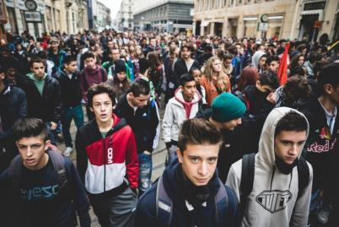
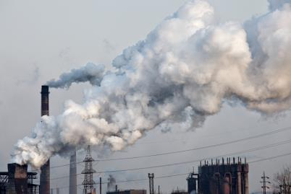
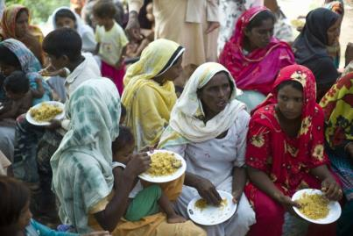


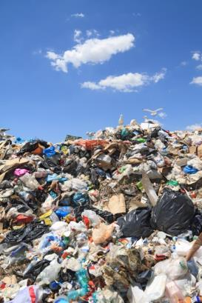
Working on grand challenges

Slide 3
TU Delft Mission
Our mission is
to explore the frontiers of the engineering sciences
to solve societal challenges
to support a competitive and sustainable economy
through
excellent creative research
science, engineering and design in one approach
excellent education
valorisation, spin through, spin out

Slide 4
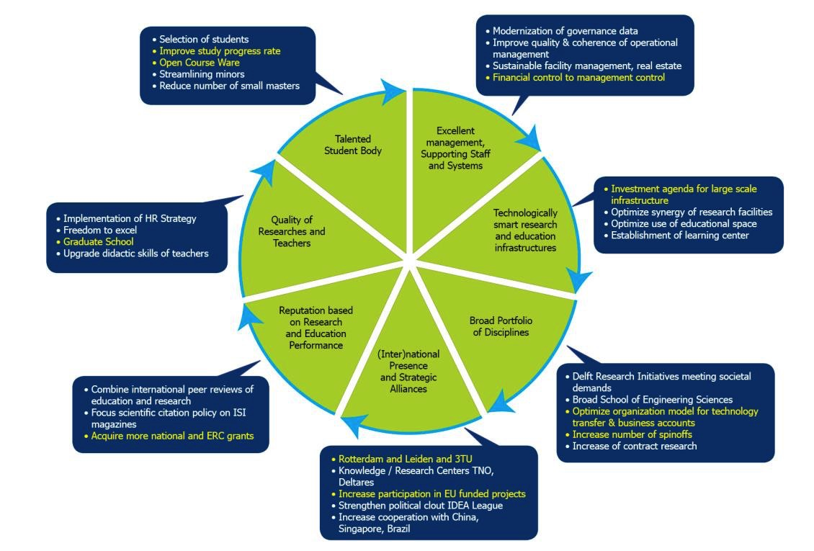
TU Delft Strategy & Actions

Slide 5
TU Delft Organisation

Slide 6
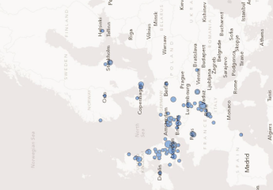
University Landscape The Netherlands
13 Research universities
240.000 students
12 universities in Top 200
World leading in Science and Health
Top 200 universities density
UK
Netherlands
Switserland / France

Slide 7
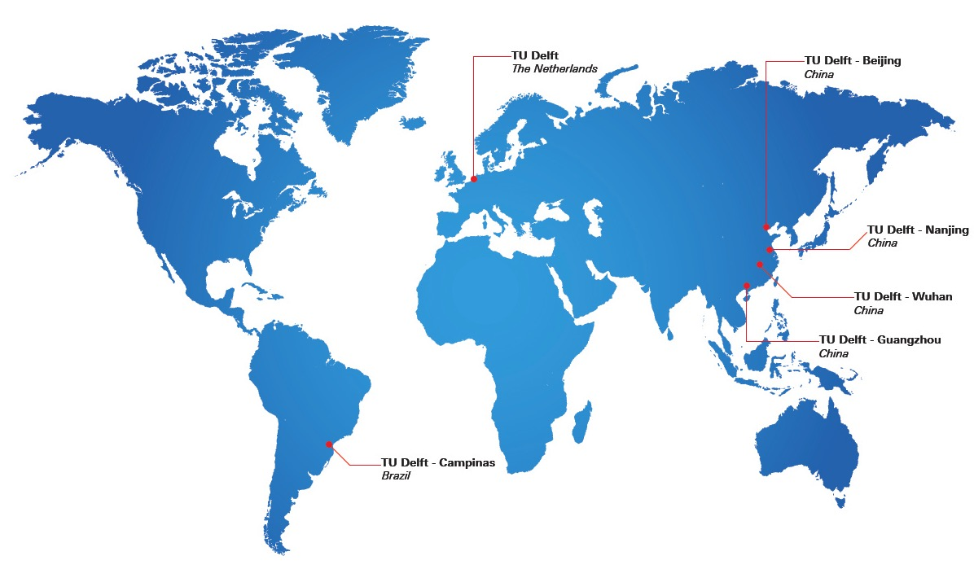
Joint research Centers
TU Delft - Vietnam

Slide 8
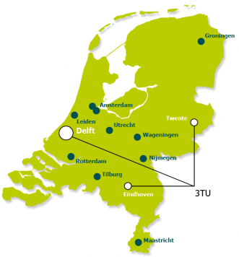
University Landscape
Silicon Valley area covers the “Randstad” (Amsterdam, Rotterdam, Den Haag, Utrecht)
55% BNP
6 Top 200 universities
Port of Rotterdam
Universities of Technology
• Delft
• Eindhoven
• Twente
• Wageningen (agriculture, food tech)

Slide 9
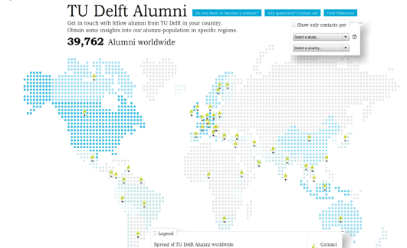
Alumni: stay in touch

Slide 10
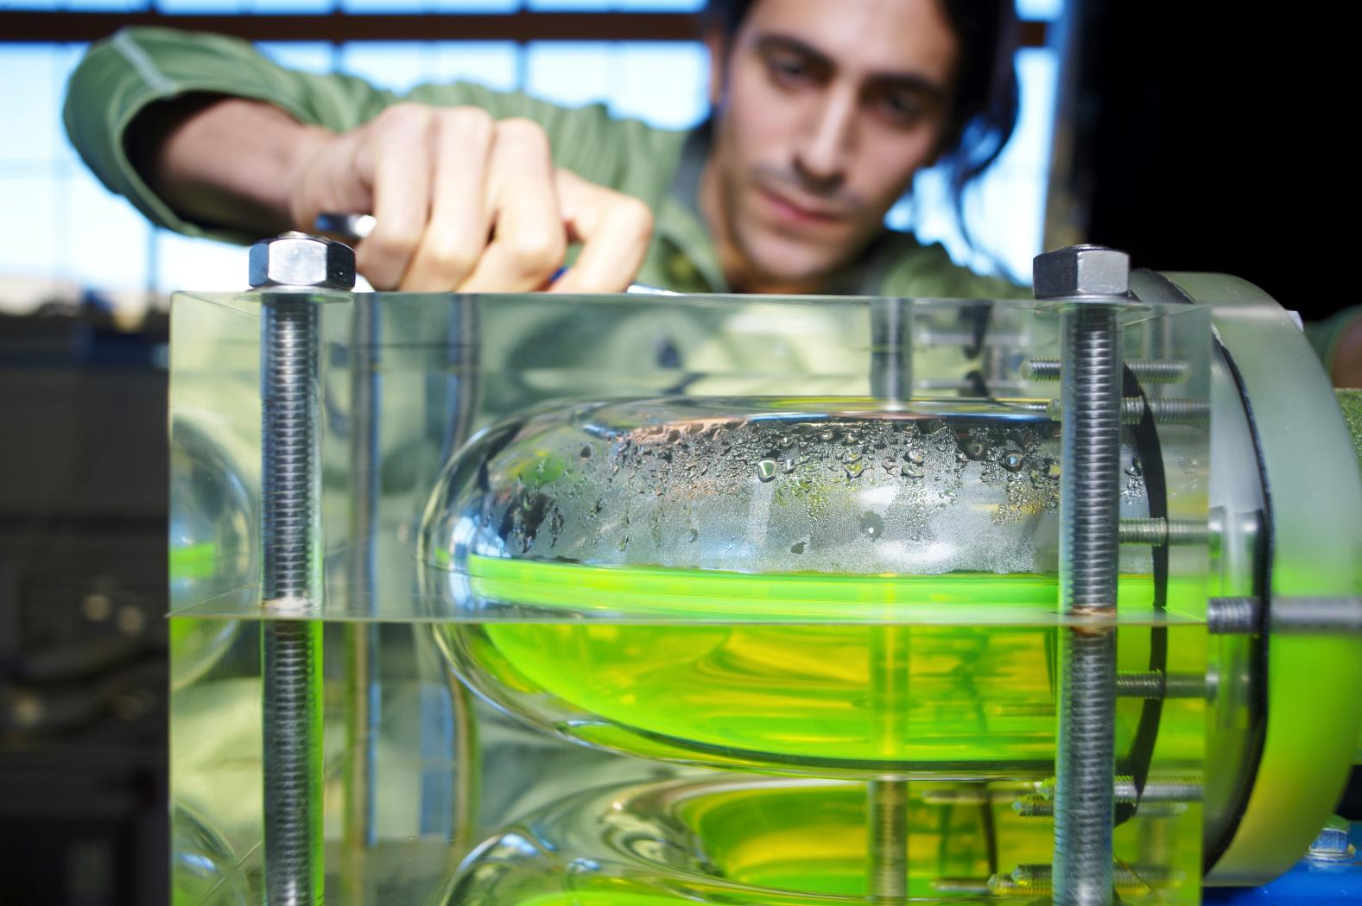
Research

Slide 11
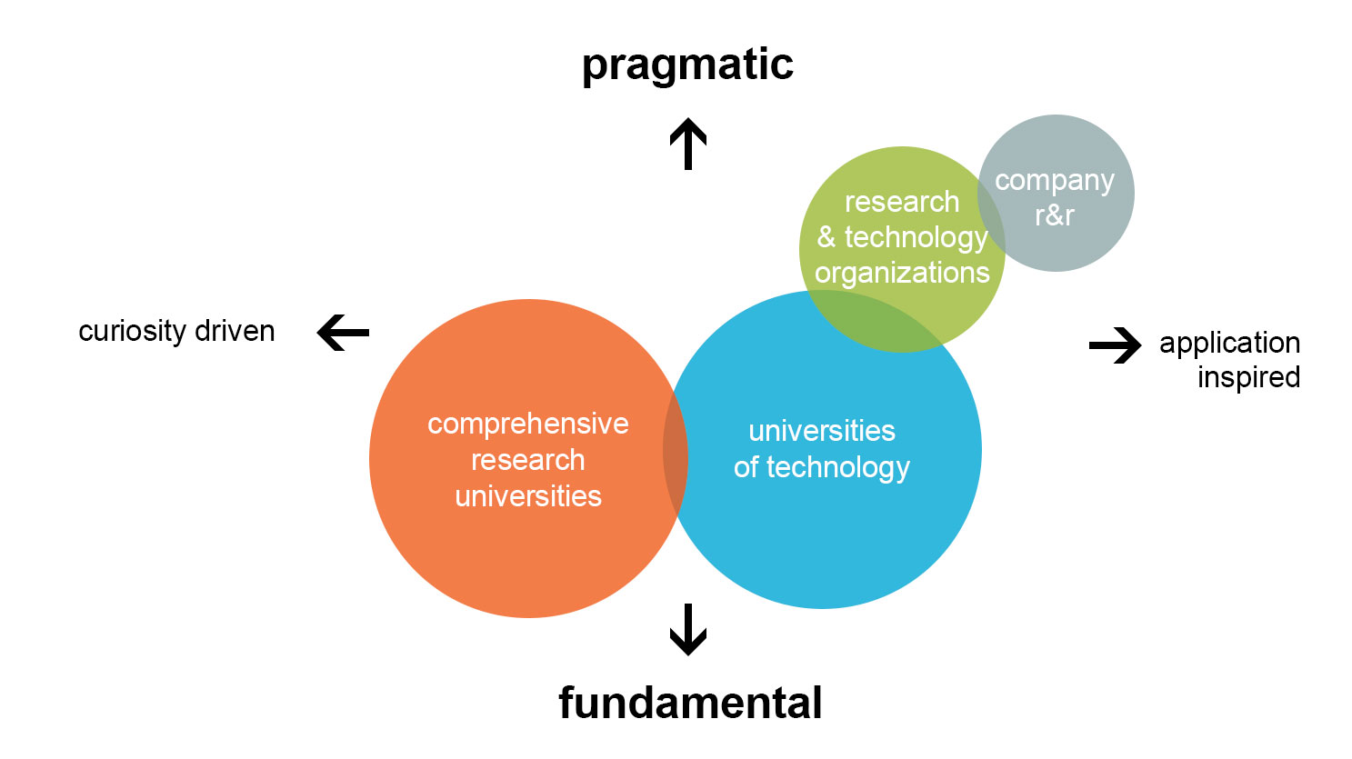
Research profile

Slide 12
Research slides - examples
The next section is filled with relevant slides with more detailed information, which can be used optionally

Slide 13
Highlights of Science
Ronald Hanson
‘Quantum mechanics is completely counter-intuitive’
Professor Ronald Hanson is Antoni van Leeuwenhoek Professor at TU Delft’s Kavli Institute for Nanosciences. Hanson and his colleagues succeeded in becoming the first in the world to move data reliably from one quantum bit to another ten feet away, without the information travelling through the intervening space. This method of teleportation represents a major step forward in the development of quantum computers and the quantum internet.

Slide 14
Highlights of Science
Arjan van Timmeren
Sustainable building blocks for intelligent cities
Arjan van Timmeren is Professor of Environmental Technology & Design at the Faculty of Architecture and the Built Environment’s Department of Urbanism. He specialises in the integration of renewable technologies into the built environment. ‘If I had to sum it up, my work involves engineering, design and integration, with users and people as a further aspect,’ says Van Timmeren.

Slide 15
Highlights of Science
Caspar Chorus
‘Not all the choices people make are selfish’
Professor Caspar Chorus gave his inaugural address entitled: ‘Choice Behaviour Modelling’. The regret mini- misation model he has developed was quickly incorporated within the most important econometrics software as an alternative for the widely used utility maximisation model. This is not a competition between the two, but rather an enrichment of the specialist area, believes Chorus: ‘My aim is to encourage people to look differently at the same material.’

Slide 16
Highlights of Science
Josien Kruizinga en Tim Jonathan
True to the concept
During the 2014 Solar Decathlon, the Olympic Games of sustainable construction, the Prêt-à-Loger student team proved a resounding success in Versailles with their concept for making existing residential constructions energy-neutral.Design Manager Josien Kruizinga and Construction Manager Tim Jonathan are proud of their performance, but they would like to see the concept be applied in practice: ‘It is time to put that enthusiasm into action.’

Slide 17
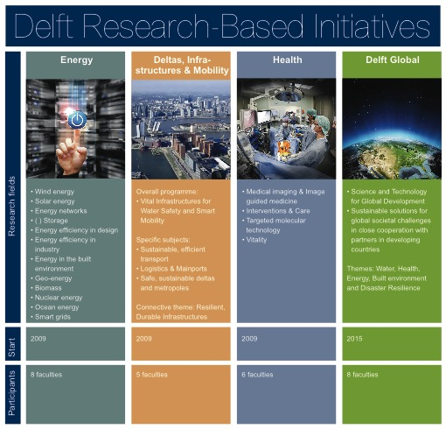

Slide 18
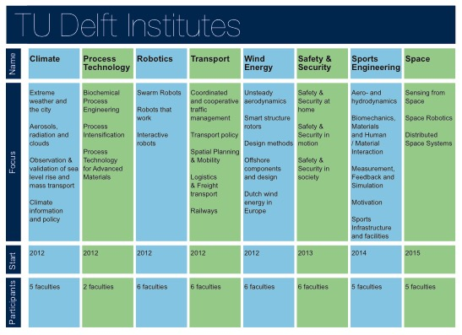

Slide 20
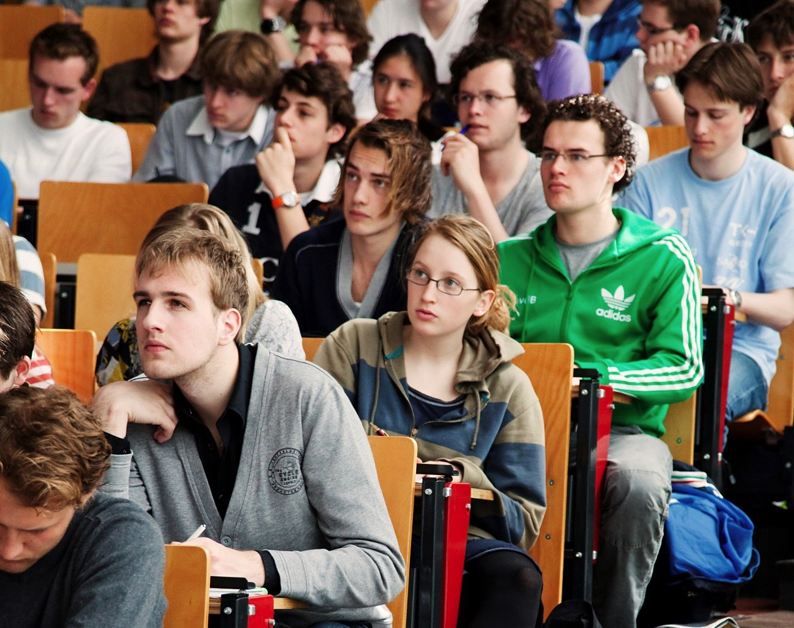
Education

Slide 21
Composition of student body 2013

Slide 22
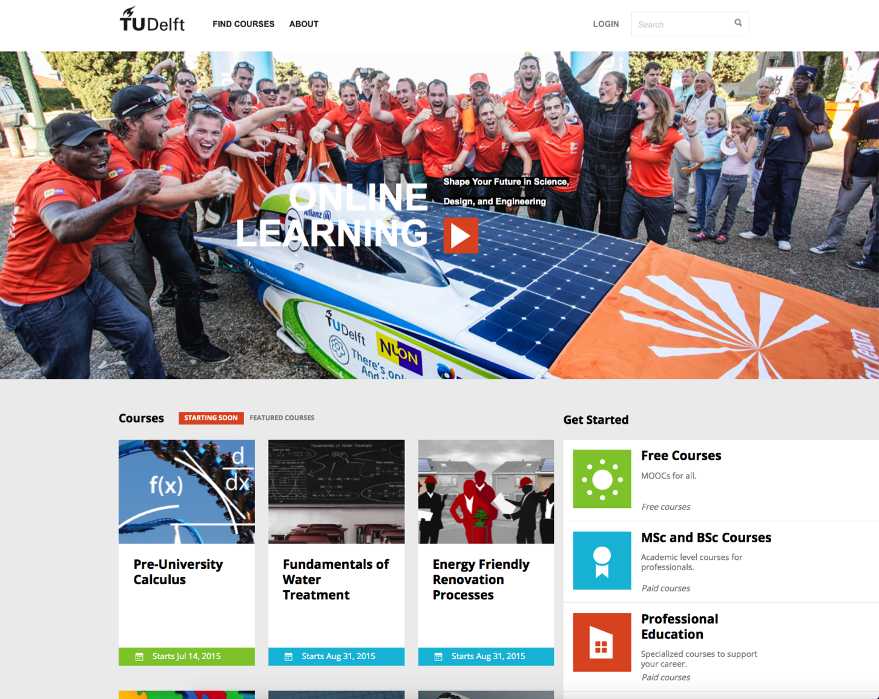
Online education
Online-learning.tudelft.nl

Slide 23
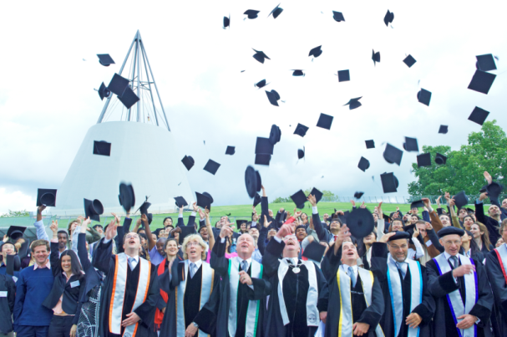
Tailoring for talented students
15 Bachelor programmes
30 Master programmes
Graduate school
Honours Programme Delft: Courses, projects, internship and workshops (total 30 EC) on top of or blended with standard MSc curriculum (120 EC) for top 5% students

Slide 24
D-dream projects
Delft - Dream Realisation of Extremely Advanced Machines (D-Dream Hall)
• Student teams work on engineering challenges
• 12 Dream teams mobilize 700 students
• High visibility, great motivator

Slide 25
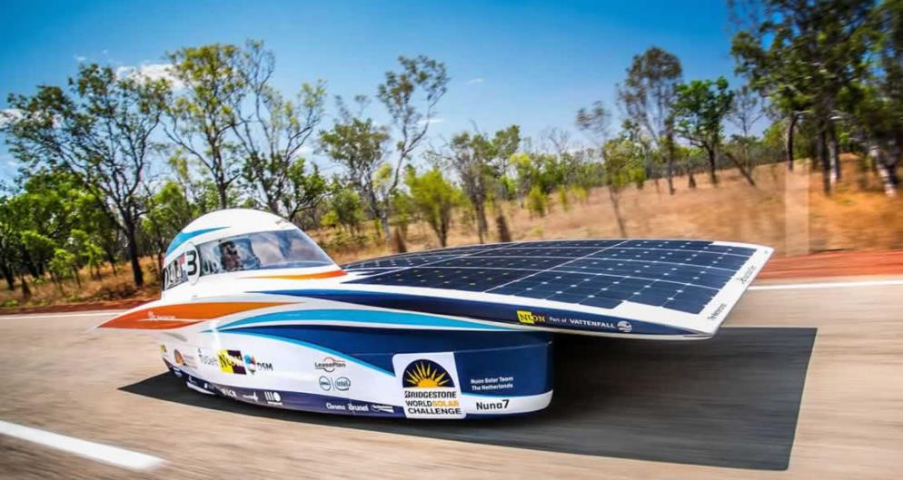
D-dream projects – Nuon Solar Team
The Nuon Solar Team participates in the two-yearly 3000 km World Solar Challenge Race from Darwin to Adelaide
• 1st place 2001, 2003, 2005, 2007 and 2013
• 2nd place in 2009 and 2011

Slide 26
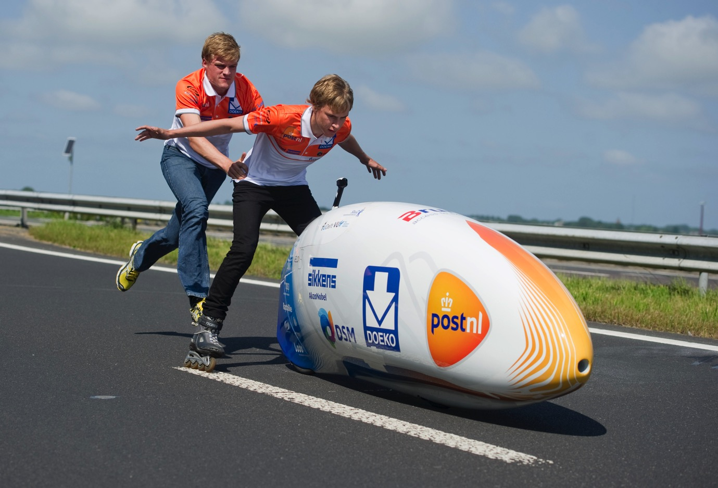
D-dream projects - Delft Fast Bike
How fast can you actually go by bike?
Students from TU Delft hold the world record with 133,86 km/h and aim to also claim the female and hour records.

Slide 27
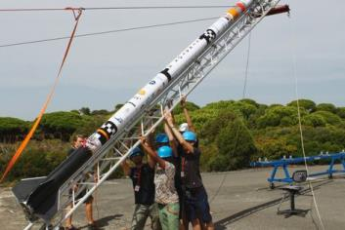
D-dream projects - Stratos
Stratos broke the European height record for experimental rockets (12.7 km). They aim for the edge of space in the near future (100 km)

Slide 28
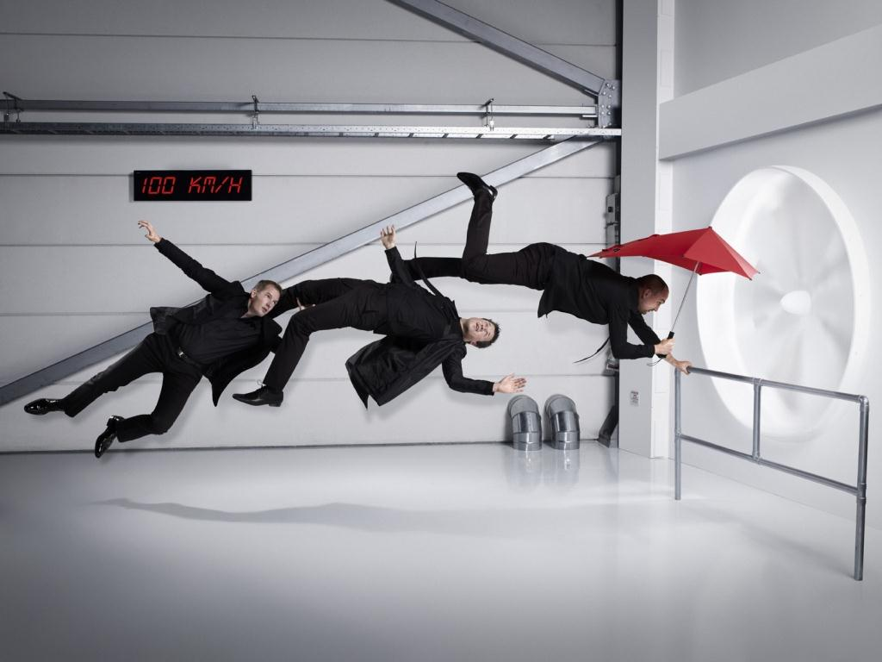
Valorisation

Slide 29
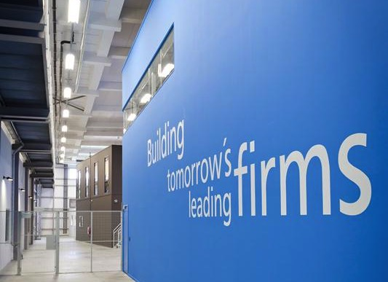
Yes!Delft
As per 2015
159 companies
1000+ employment
EUR 130 Million invested capital
EUR 97 Million generated revenue

Slide 30
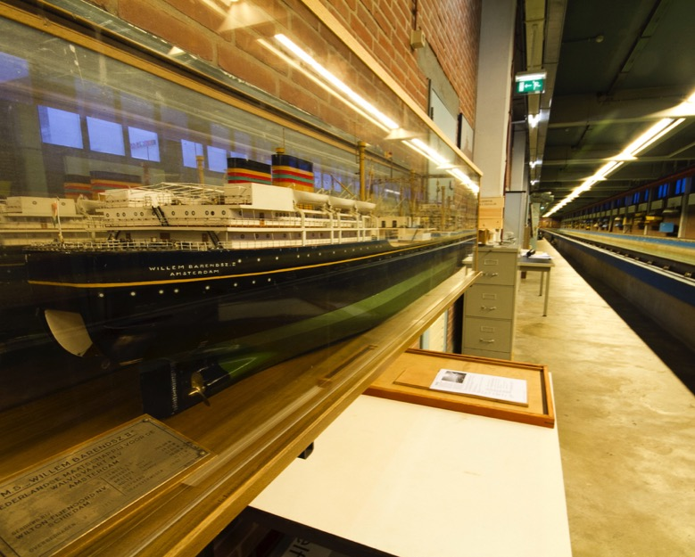
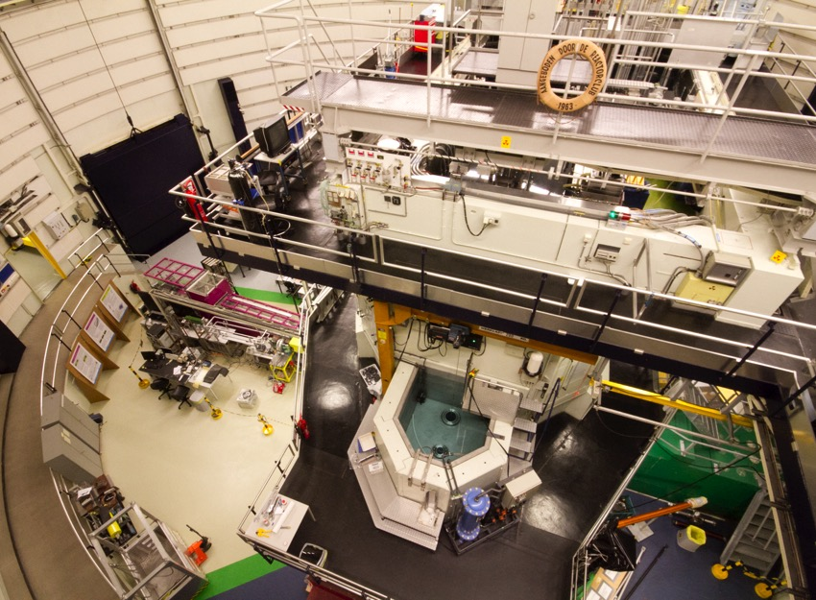
Research facilities
High-voltage engineering laboratory
Cleanroom (DIMES)
Wind tunnels
Water basins for coastal and marine research
Experimental Nuclear Reactor
Aerospace facilities (e.g. jetplane, flight simulator)
Radar and telecommunication test facilities

Slide 31
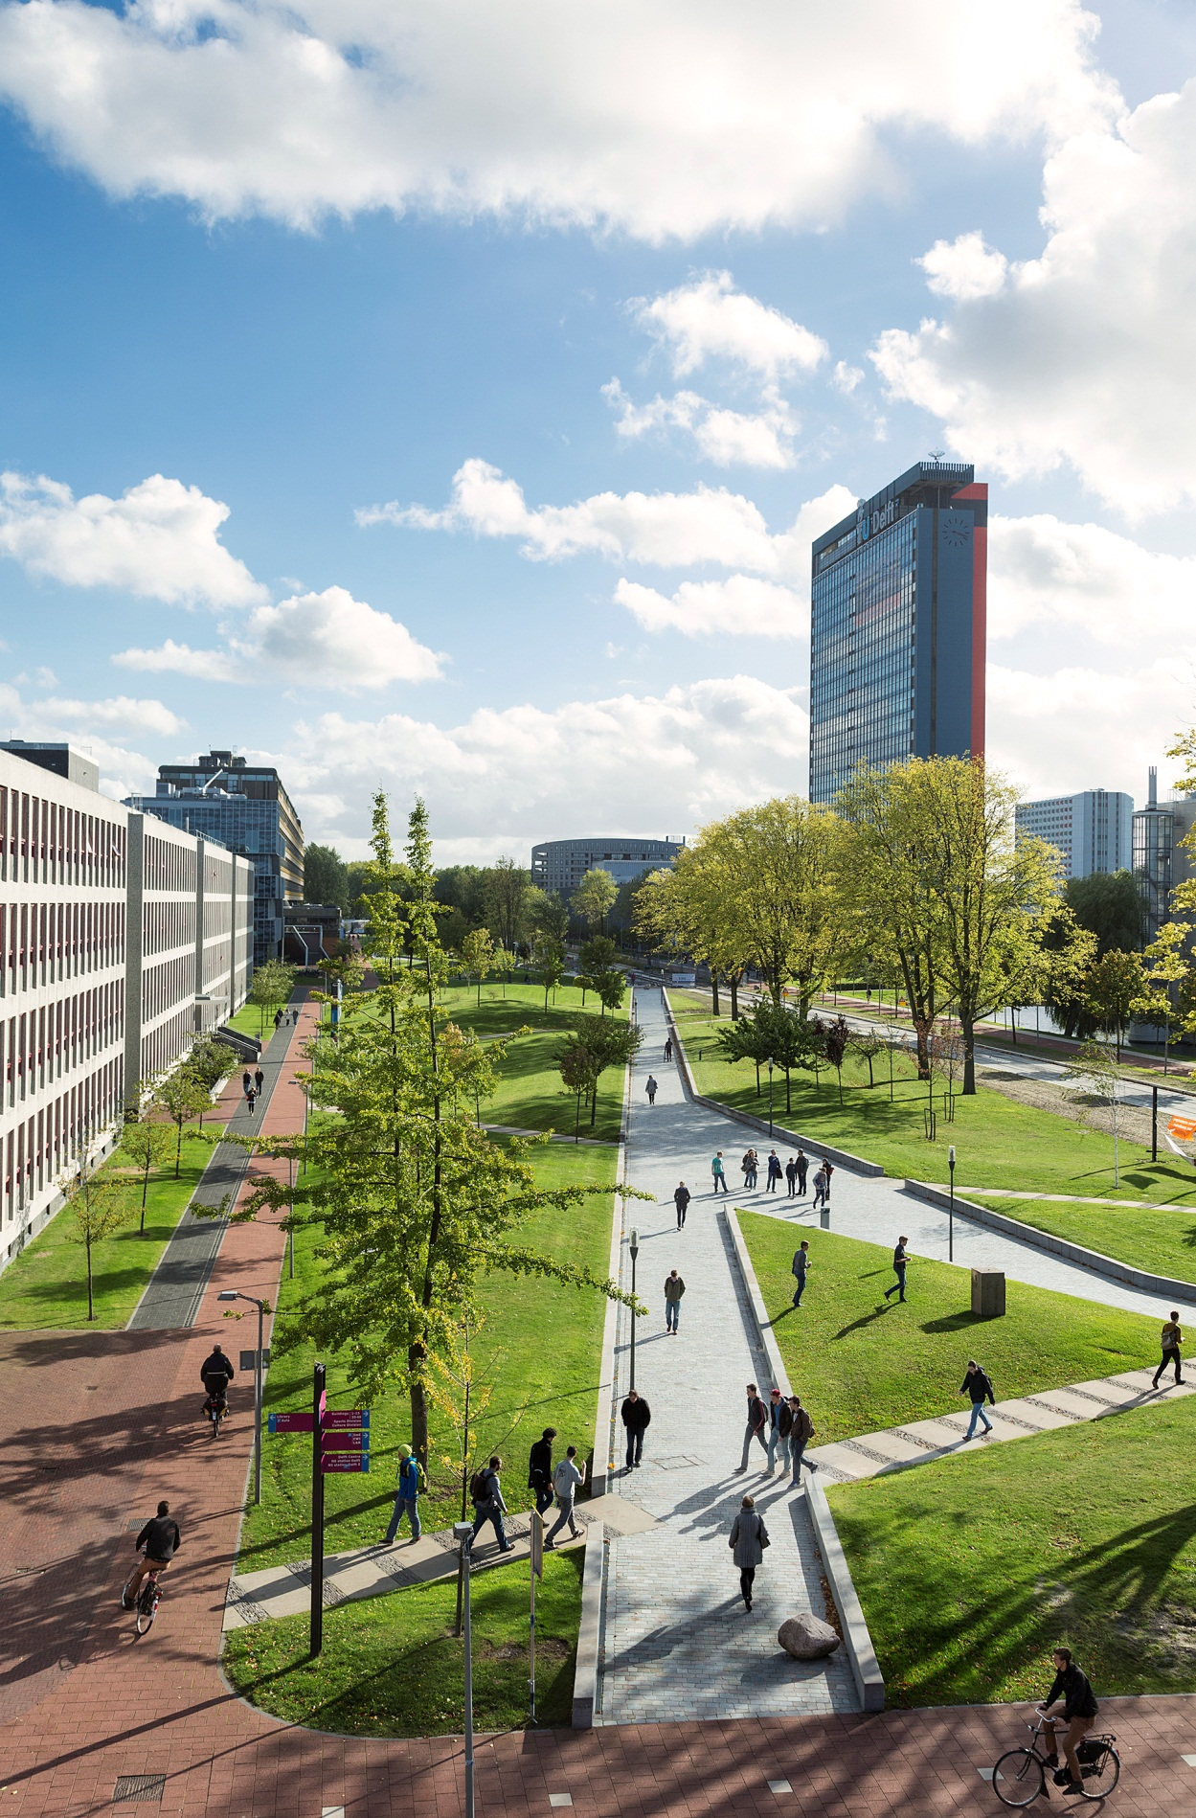
A lively campus
A living campus

Slide 32
Composition of Revenue and Expenditure

